Slide 1
Introduction to ML

Slide 2
Introduction
We have seen Machine Learning as a buzzword for the past few years, the reason for this might be the high amount of data production by applications, the increase of computation power in the past few years and the development of better algorithms.
Machine Learning, in the simplest of terms, is teaching your machine about something. You collect data, clean the data, create algorithms, teach the algorithm essential patterns from the data and then expect the algorithm to give you a helpful answer. If the algorithm lives up to your expectations, you have successfully taught your algorithm. If not, just scrap everything and start from scratch. That is how it works here.
A formal definition, Machine Learning is the process of creating models that can perform a certain task without the need for a human explicitly programming it to do something.

Slide 3
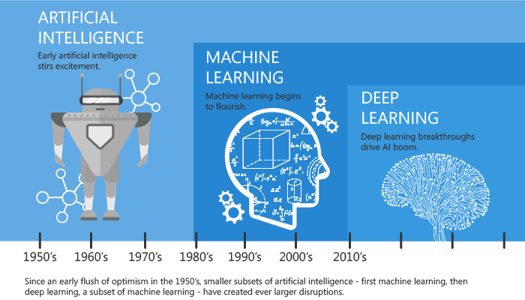
A Quick History of Machine Learning

Slide 4
What is Machine Learning?
According to Arthur Samuel, Machine Learning algorithms enable the computers to learn from data, and even improve themselves, without being explicitly programmed.
Machine learning (ML) is a category of an algorithm that allows software applications to become more accurate in predicting outcomes without being explicitly programmed. The basic premise of machine learning is to build algorithms that can receive input data and use statistical analysis to predict an output while updating outputs as new data becomes available.

Slide 5
Types of Machine Learning?
Machine learning can be classified into 3 types of algorithms.
Supervised Learning
Unsupervised Learning
Reinforcement Learning

Slide 6
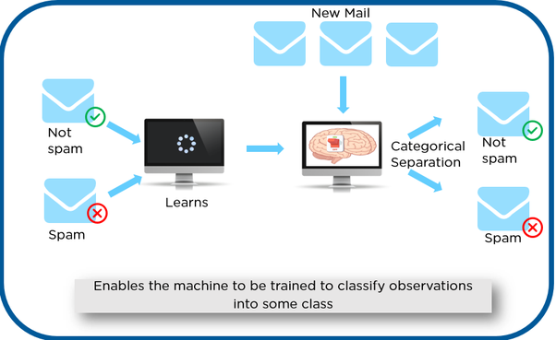
Supervised learning
In Supervised learning, an AI system is presented with data which is labeled, which means that each data tagged with the correct label.
The goal is to approximate the mapping function so well that when you have new input data (x) that you can predict the output variables (Y) for that data.

Slide 7
Types of Supervised learning
Classification: A classification problem is when the output variable is a category, such as “red” or “blue” or “disease” and “no disease”.
Regression: A regression problem is when the output variable is a real value, such as “dollars” or “weight”.

Slide 8
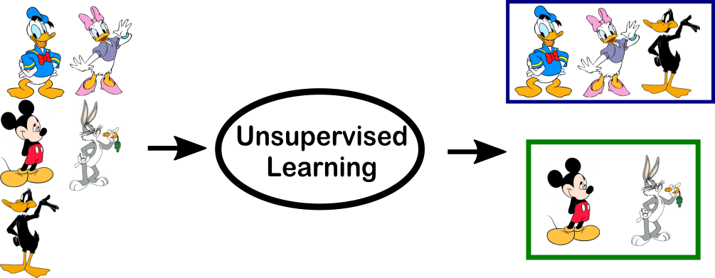
Unsupervised Learning
In unsupervised learning, an AI system is presented with unlabeled, uncategorized data and the system’s algorithms act on the data without prior training. The output is dependent upon the coded algorithms. Subjecting a system to unsupervised learning is one way of testing AI.

Slide 9
Types of Unsupervised learning
Clustering: A clustering problem is where you want to discover the inherent groupings in the data, such as grouping customers by purchasing behavior.
Association: An association rule learning problem is where you want to discover rules that describe large portions of your data, such as people that buy X also tend to buy Y.

Slide 10
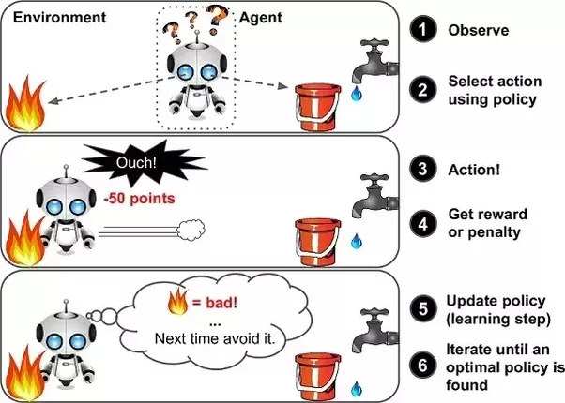
Reinforcement Learning
A reinforcement learning algorithm, or agent, learns by interacting with its environment. The agent receives rewards by performing correctly and penalties for performing incorrectly. The agent learns without intervention from a human by maximizing its reward and minimizing its penalty. It is a type of dynamic programming that trains algorithms using a system of reward and punishment.

Slide 11
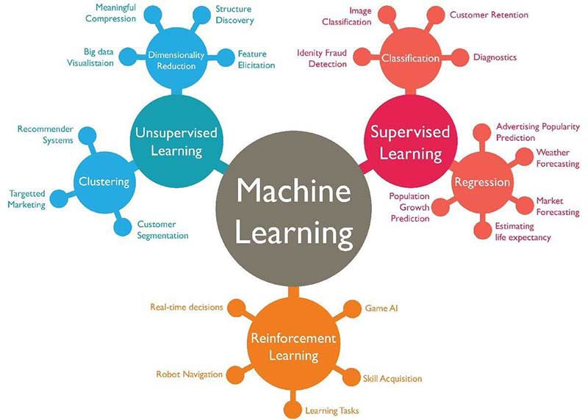
Cheat sheet

Slide 12
Difference between Supervised and Unsupervised Learning
Supervised learning: Supervised learning is the learning of the model where with input variable ( say, x) and an output variable (say, Y) and an algorithm to map the input to the output.
That is, Y = f(X)
The basic aim is to approximate the mapping function(mentioned above) so well that when there is a new input data (x) then the corresponding output variable can be predicted.

Slide 13
Unsupervised Learning: Unsupervised learning is where only the input data (say, X) is present and no corresponding output variable is there.
The main aim of Unsupervised learning is to model the distribution in the data in order to learn more about the data.
It is called so, because there is no correct answer and there is no such teacher(unlike supervised learning). Algorithms are left to their own devises to discover and present the interesting structure in the data.

Slide 14
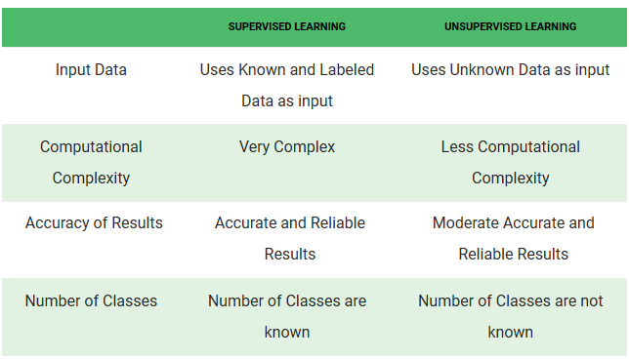
Supervised vs Unsupervised Learning

Slide 15
Challenges in Machines Learning
Quality of data − Having good-quality data for ML algorithms is one of the biggest challenges. Use of low-quality data leads to the problems related to data pre-processing and feature extraction.
Time-Consuming task − Another challenge faced by ML models is the consumption of time especially for data acquisition, feature extraction and retrieval.
Issue of overfitting & underfitting − If the model is overfitting or underfitting, it cannot be represented well for the problem.
Curse of dimensionality − Another challenge ML model faces is too many features of data points. This can be a real hindrance

Slide 16
Applications of Machine Learning
Machine Learning is used anywhere from automating mundane tasks to offering intelligent insights, industries in every sector try to benefit from it. You may already be using a device that utilizes it. For example, a wearable fitness tracker like Fitbit, or an intelligent home assistant like Google Home. But there are much more examples of ML in use.
Prediction — Machine learning can also be used in the prediction systems. Considering the loan example, to compute the probability of a fault, the system will need to classify the available data in groups.
Image recognition — Machine learning can be used for face detection in an image as well. There is a separate category for each person in a database of several people.

Slide 17
Speech Recognition — It is the translation of spoken words into the text. It is used in voice searches and more. Voice user interfaces include voice dialing, call routing, and appliance control. It can also be used a simple data entry and the preparation of structured documents.
Medical diagnoses — ML is trained to recognize cancerous tissues.
Financial industry and trading — companies use ML in fraud investigations and credit checks.

